Slide 1
OpenShift Labs
OW

Slide 2
CodeReady Containers
Using CodeReady Containers (CRC), an OpenShift 4 cluster that runs on your local computer in a single VM. This cluster provides a minimal environment for developing and testing purposes, including everything you need to get started.
CRC is a single node container
CRC requires at least the following system resources:
4 virtual CPUs (vCPUs)
9 GB of free memory
35 GB of storage space

Slide 3
CRC Operating System Requirements
Windows Windows 10 Fall Creators Update (version 1709) or newer; Windows 10 Home Edition is not supported.
macOS OS X 10.4 Mojave or newer
Linux Officially supported on Red Hat Enterprise Linux/CentOS 7.5 or newer, or the latest two stable Fedora releases

Slide 4

Installing CRC
1. Head to Red Hat OpenShift Cluster Manager and log in to your Red Hat account

Slide 5
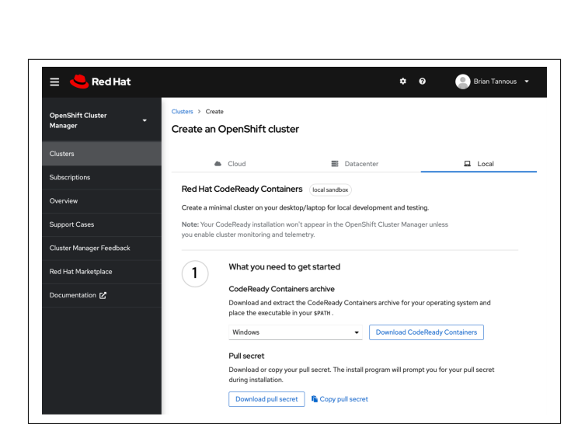
..
Download the latest version of CRC for your operating system and download your pull secret. The pull secret encodes your CRC license entitlement for CRC and OpenShift components retrieved from Red Hat repositories.

Slide 6
..
Install the crc command on your machine by placing it within your terminal session’s path.
Run crc setup. You will likely need to provide administrative access. Be sure to read the command’s output, as the logs might mention that you need to reboot to continue.
Now you can start CRC by specifying at least the default 4-vCPU and 9 GiB memory configuration.
Execute: crc start -p pull-secret.txt -m 9216 -c 4:

Slide 7
Login to OpenShift
The server is accessible via web console at:
https://console-openshift-console.apps-crc.testing Log in as administrator:
Username: kubeadmin Password: un1Q-g3n3r8d # Note: Your password will be different.
Log in as user: Username: developer Password: developer
Use the 'oc' command line interface: PS> & crc oc-env | Invoke-Expression PS> oc login -u developer https://api.crc.testing:6443

